Slide 1


Development of an Inventory and Sales Management System Using Modern Software Engineering Practices
COURSE: Software Engineering
COURSE CODE: CSA1014
PRESENTED BY:
VIMALA K (192424276)
JOTHIKA S U(192524122)
GUIDED BY:
DR. Arivukarasi M

Slide 2
Introduction
Inventory and Sales Management Systems (ISMS) are software applications that help businesses track stock levels, orders, sales, and deliveries in real time.
Manual or spreadsheet-based inventory tracking is error-prone, time-consuming, and does not scale with business growth.
This project applies modern software engineering practices — requirement analysis, modular design, version control, testing, and agile methodology — to build a robust, scalable, and maintainable ISMS.
The system aims to bridge the gap between inventory control and sales operations by integrating them into a single unified platform.

Slide 3
Objective
To design and develop a web-based Inventory and Sales Management System that automates stock tracking and sales recording.
To apply software engineering principles (SDLC, modular architecture, testing, version control) throughout development.
To reduce human error and manual effort in inventory and billing processes.
To generate real-time reports on stock levels, sales trends, and profit/loss.
To ensure the system is scalable, secure, and user-friendly for small and medium businesses.

Slide 4
Problem Statement
Many small and medium-sized businesses still rely on manual registers or basic spreadsheets to manage inventory and sales.
This leads to:
Frequent stock mismatches (overstocking or stockouts)
Delayed and inaccurate sales reporting
No real-time visibility into inventory status
Difficulty in tracking supplier and customer transactions
Increased chances of human error in billing and record-keeping
There is a need for an integrated, automated system that applies proper software engineering methodology to ensure reliability, maintainability, and ease of use.

Slide 5
Literature Review
Year | Author(s) | Title | Key Contribution
2026 | Guseva | Applying Machine Learning Techniques to Manage Inventory in Retail Stores | Proposed combining traditional time-series methods with LSTM-based machine learning for retail demand forecasting, helping improve inventory planning in complex market conditions. (ResearchGate)
2025 | Bhatt & Nahar | Smart Retail Inventory Management Using AI-Driven IoT | Proposed an inventory framework integrating AI, IoT, RFID, and cloud computing for real-time inventory tracking, demand forecasting, stock optimization, and automated decision-making. (EBSCO OpenURL)
2024 | Ramachandran et al. | Improving Retail Industry Inventory Management Using Machine Learning | Applied machine-learning algorithms to retail inventory management and demonstrated how data-driven approaches can improve inventory planning and management efficiency. (ResearchGate)
2023 | Aguirregabiria & Guiton | Decentralized Decision-Making in Retail Chains: Evidence from Inventory Management | Studied inventory decisions across retail stores and showed the importance of timely information and coordinated inventory decision-making for reducing management costs. (arXiv)
2022 | Zietsman & van Vuuren | A Generic Framework for Decision Support in Retail Inventory Management | Proposed an integrated framework covering product segmentation, demand forecasting, and replenishment decisions, highlighting the need for computerized decision-support systems in modern inventory management. (arXiv)

Slide 6
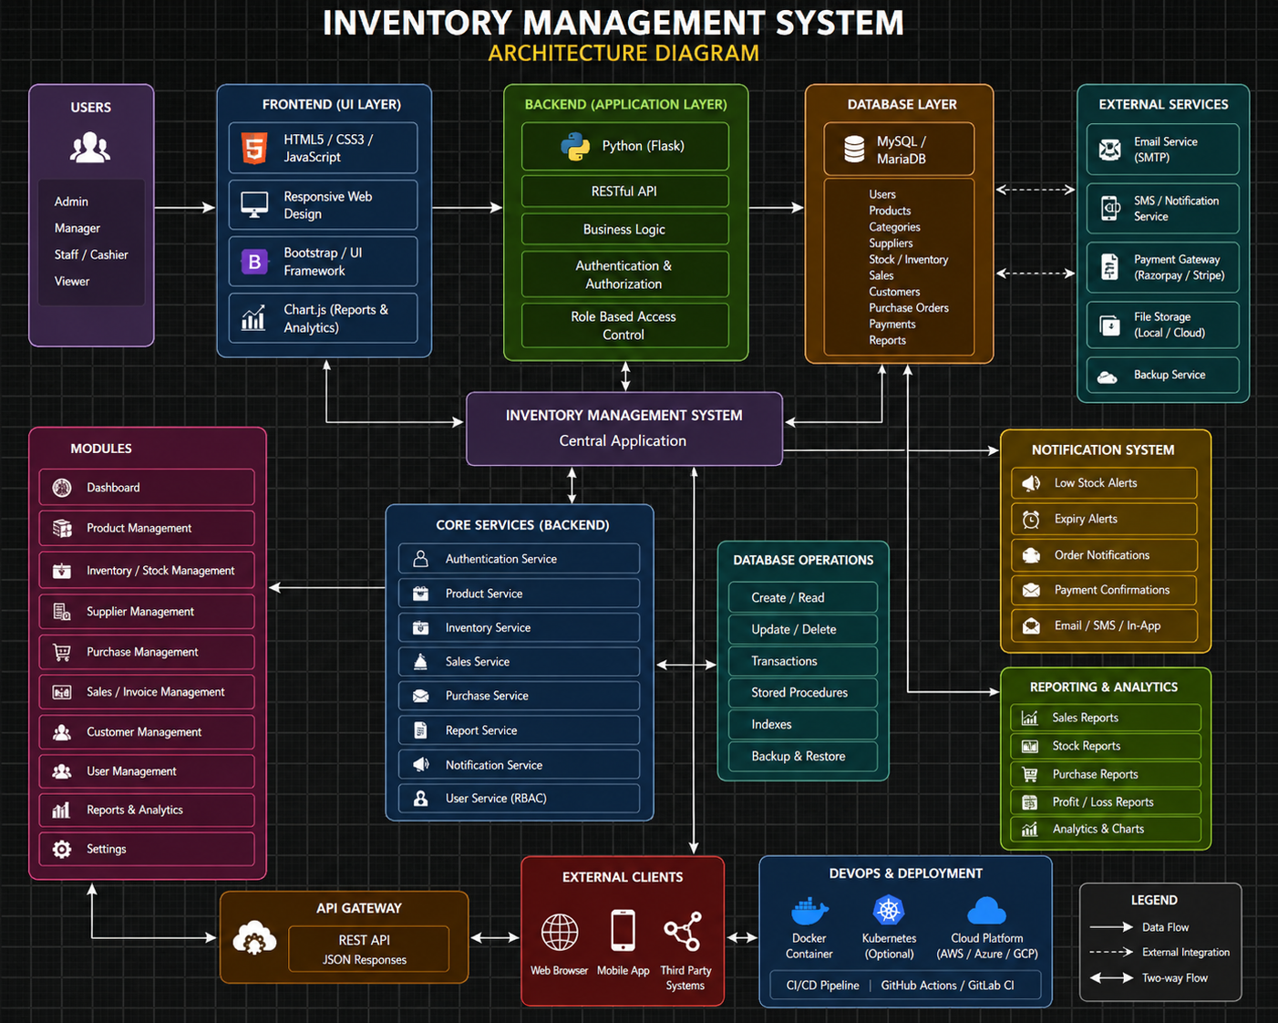
Archietecture Diagram

Slide 7
Module 1: User Interface & Interaction
Covers everything the user directly sees and interacts with on screen.
Login/logout interface with role-based views (Admin, Manager, Staff)
Product listing, stock display, and category browsing screens
Billing/invoicing interface for sales entry and discount handling
Customer-facing forms (add/search customers, view purchase history)
Dashboards for sales reports, stock reports, and profit/loss visualization
Real-time notifications and low-stock alert pop-ups.

Slide 8
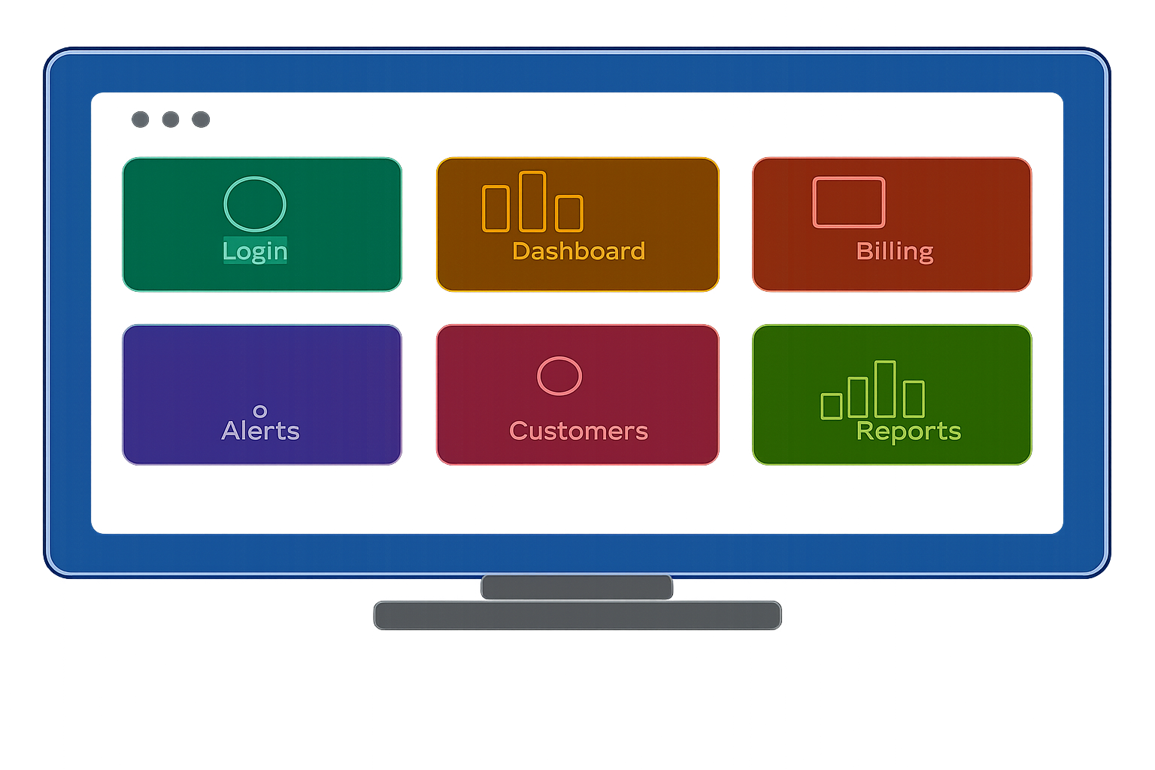

Slide 9
Module 2: Core Processing & Data Management Module
Covers all the processing, storage, and business logic working behind the scenes.
Authentication & authorization logic (role validation, session management)
Inventory logic — add/update/delete products, stock level calculations
Sales processing logic — order calculations, invoice generation
Supplier & purchase order management, restocking logic
Database management — centralized storage, backup, and retrieval
Report generation logic and analytics computation
Notification-triggering logic (low-stock thresholds, order confirmations)

Slide 10
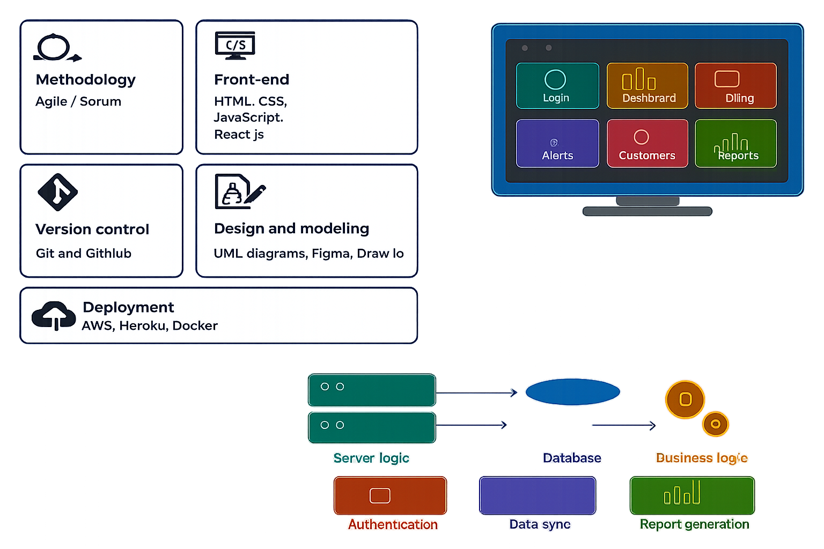

Slide 11
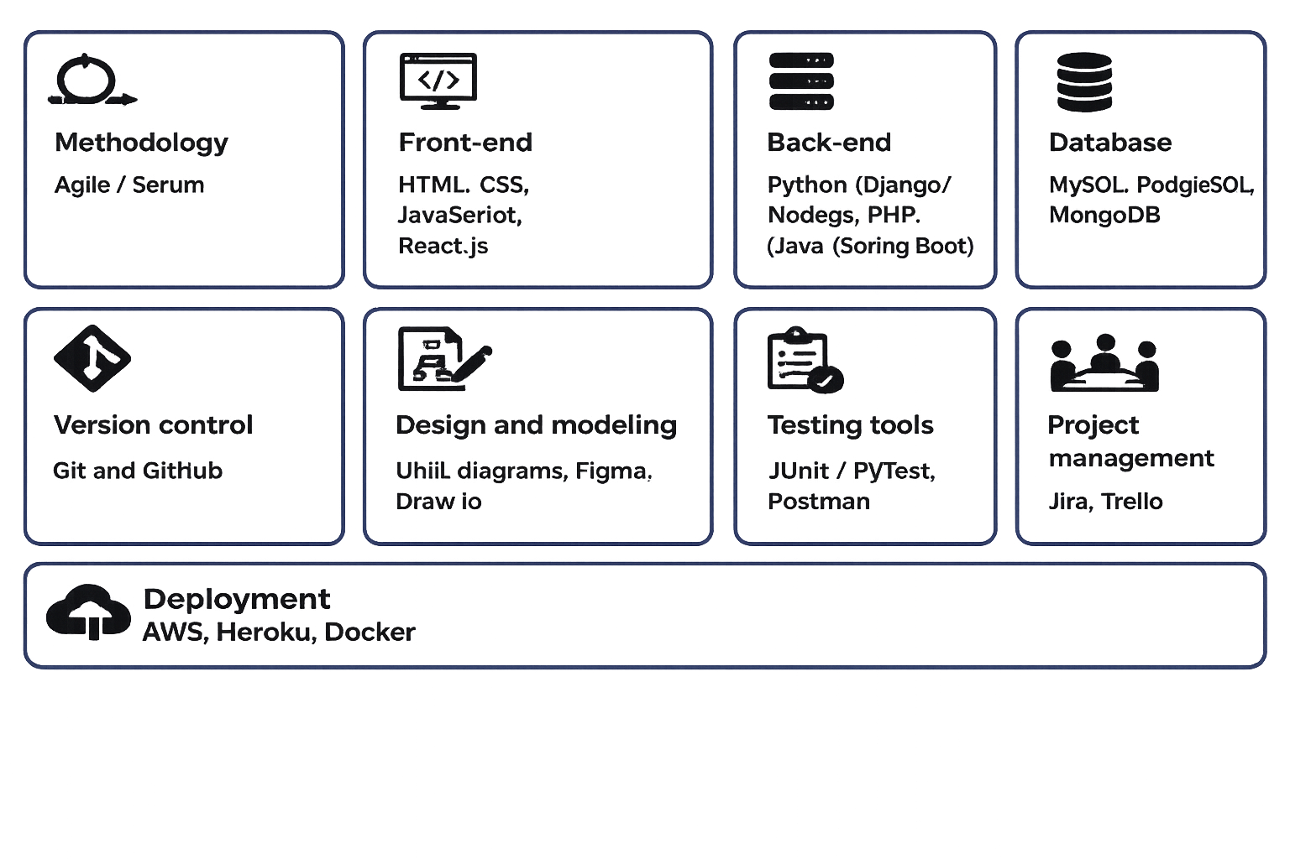
Tools Used

Slide 12
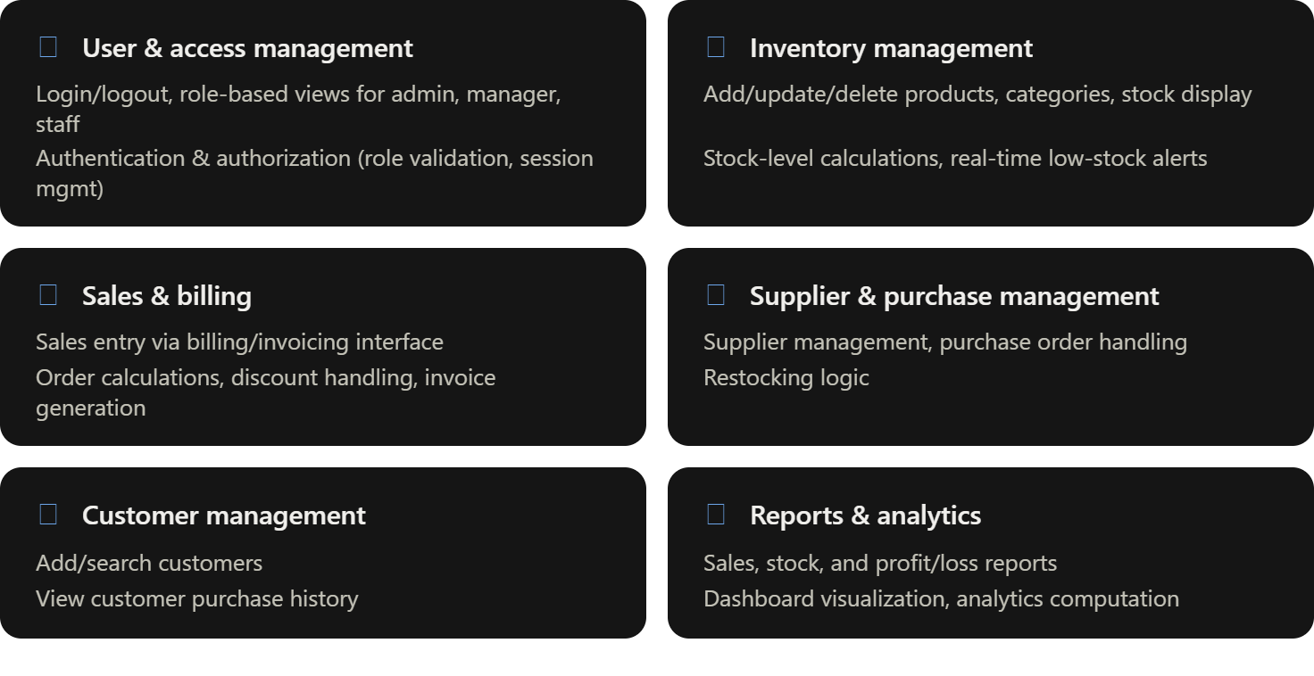
Scope OF System

Slide 13
Expected Results
A fully functional Inventory and Sales Management System with real-time stock tracking and automated billing.
Reduced manual errors in inventory and sales data entry.
Improved decision-making through analytical dashboards and reports.
A scalable system architecture that follows modular software engineering design, allowing easy future enhancements.
Faster processing of sales transactions and inventory updates compared to manual methods.
Positive usability feedback from test users (business owners/staff) regarding ease of use and efficiency.

Slide 14
References
Guseva, A. (2026). Applying Machine Learning Techniques to Manage Inventory in Retail Stores. ResearchGate.
Bhatt, S., & Nahar, P. (2025). Smart Retail Inventory Management Using AI-Driven IoT. Journal of Supply Chain Management and Systems.
Ramachandran, K. K., Karthick, K. K., Nalla Bala Kalyan, & Tiwari, M. (2024). Improving Retail Industry Inventory Management Using Machine Learning. CRC Press, Recent Technological Advances in Engineering and Management.
Ganguly, P., & Mukherjee, I. (2024). Enhancing Retail Sales Forecasting with Optimized Machine Learning Models. arXiv.
Zietsman, H. J., & van Vuuren, J. H. (2022). A Generic Framework for Decision Support in Retail Inventory Management. arXiv.

